Slide 2
Equitable State Response to COVID-19 and Stronger Recovery
Cortney Sanders and Jesse Cross-Call
Center on Budget and Policy Priorities

Slide 3
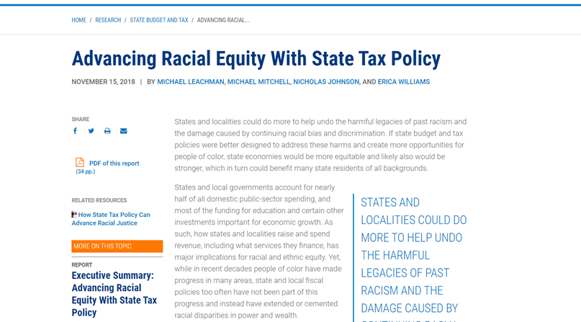

Slide 4
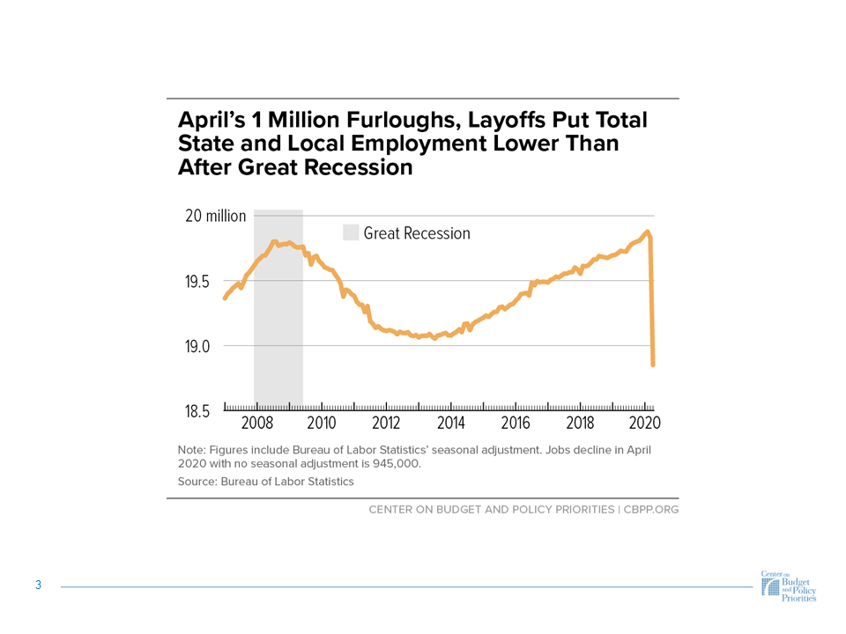
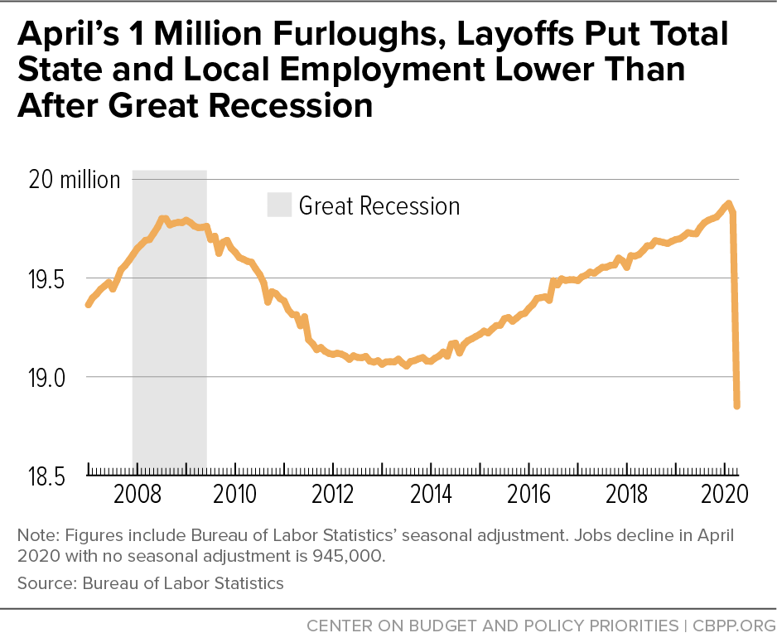

Slide 5
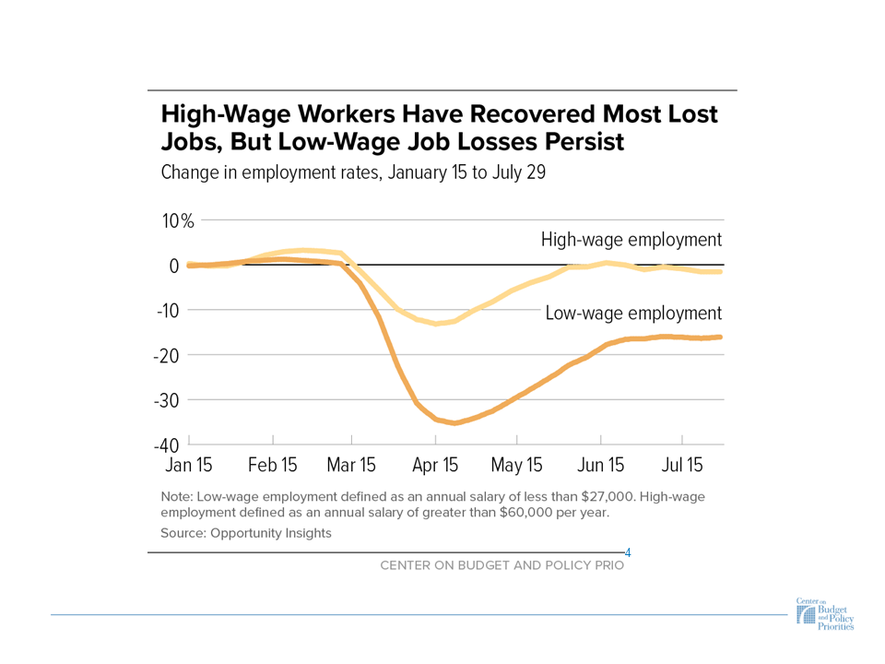
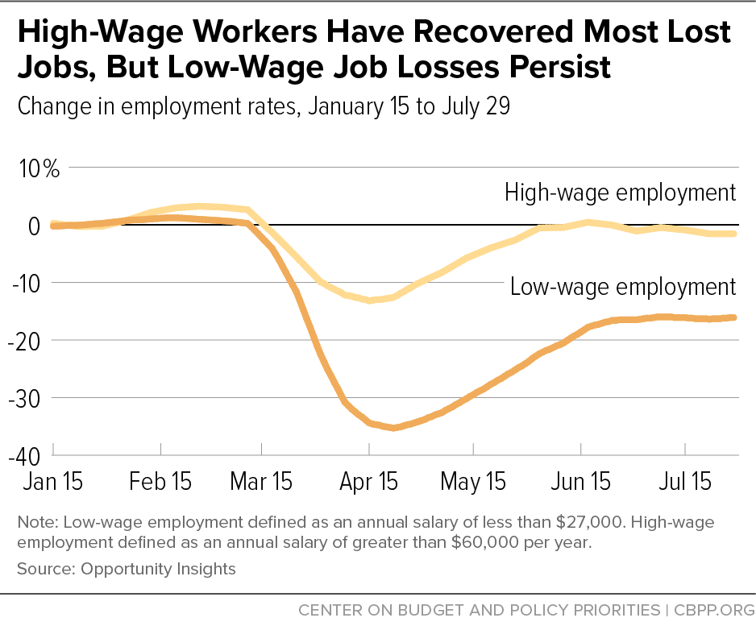

Slide 6
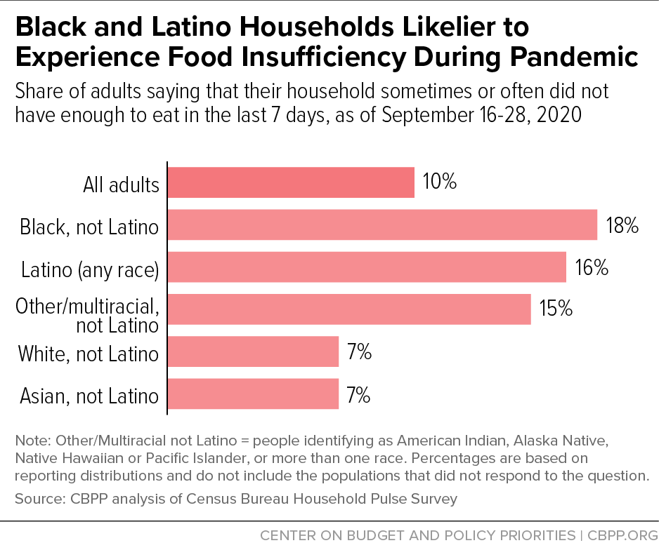

Slide 7
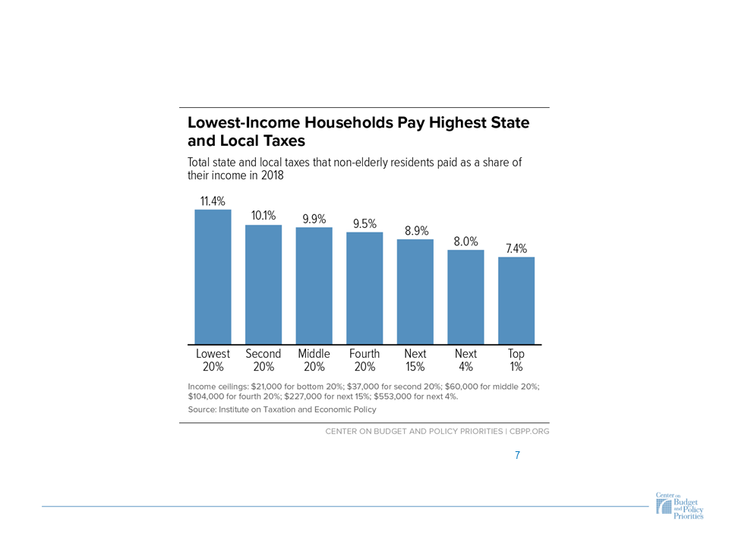
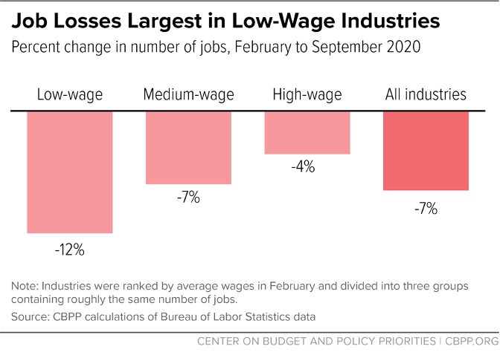

Slide 8
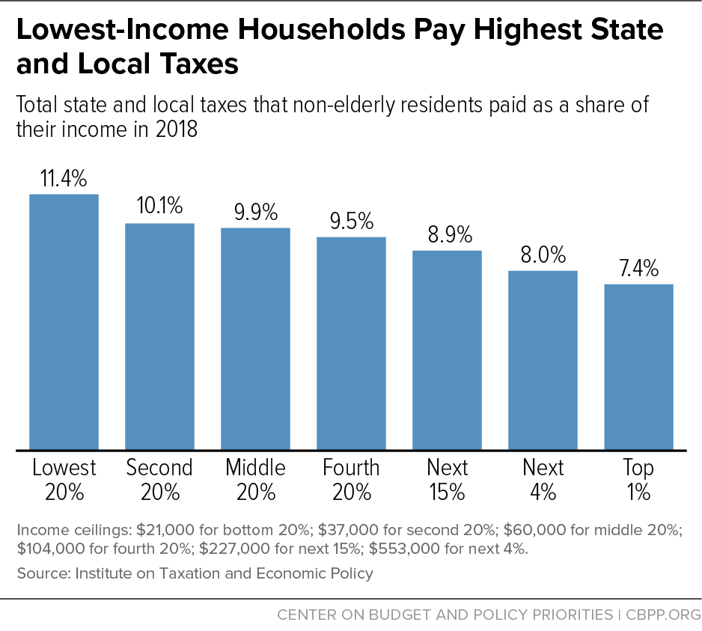

Slide 9
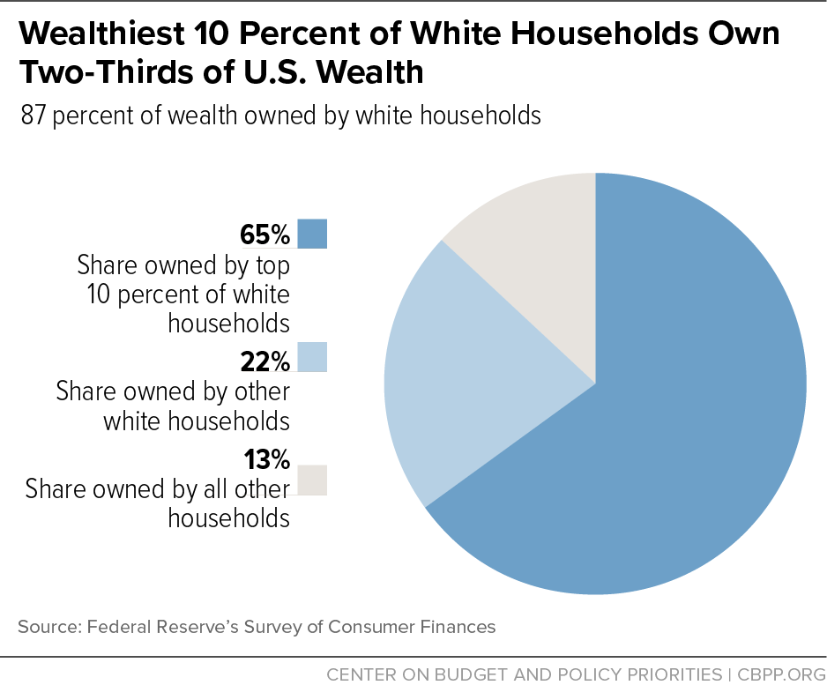

Slide 15
Cortney Sanders
csanders@cbpp.org
www.cbpp.org
202.408.1080

Slide 16
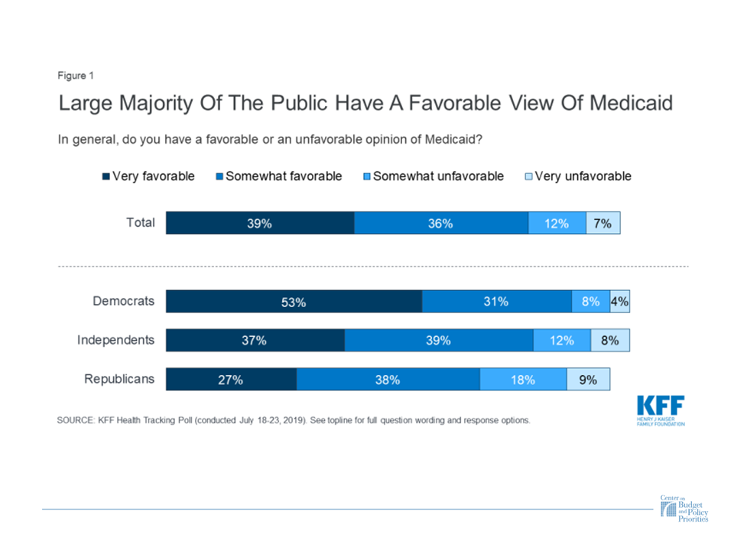

Slide 17
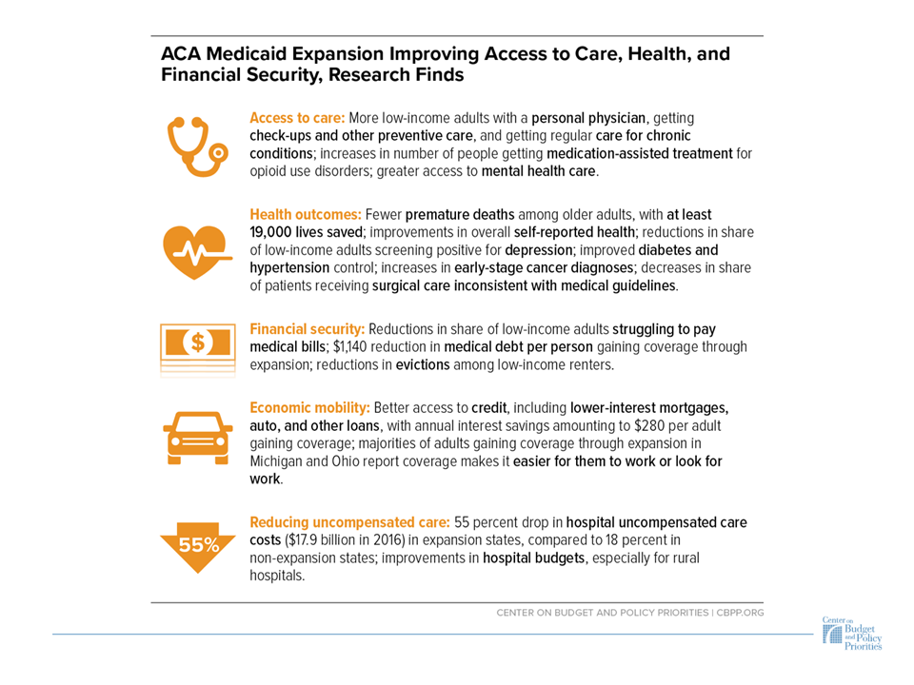

Slide 18
Medicaid’s Role in Addressing Racial Disparities
Narrows disparities in coverage and access to care
Earlier diagnosis and treatment of cancer among Black people
Lower maternal mortality, especially among Black women
Improvements in physical health, especially among Black people

Slide 19
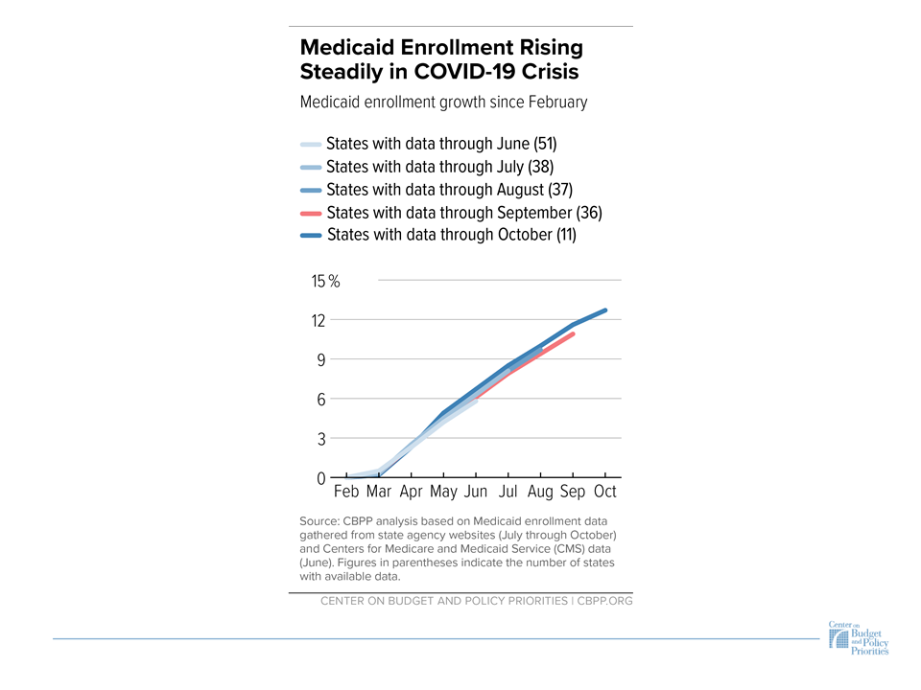
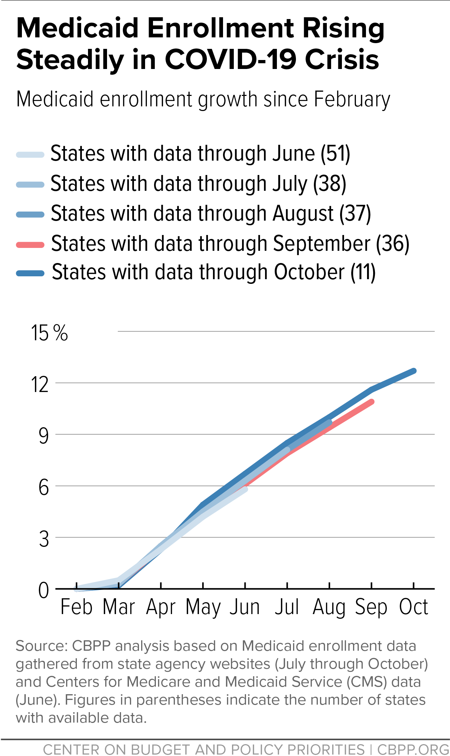

Slide 20
Medicaid’s Importance During a Pandemic

Slide 21
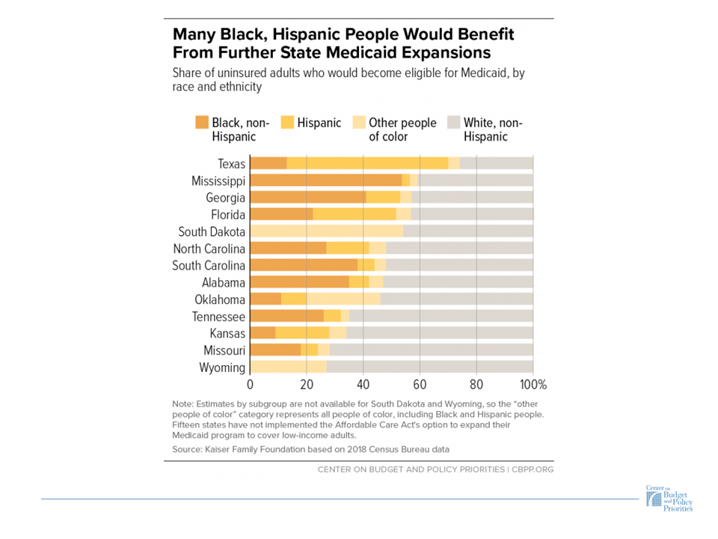
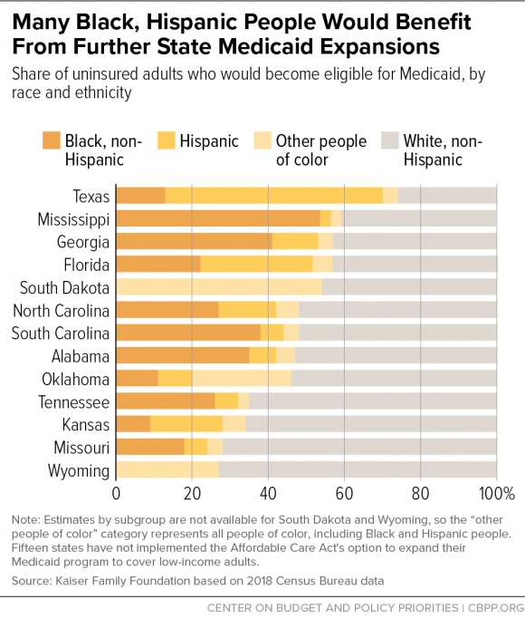

Slide 22
Jesse Cross-Call
cross-call@cbpp.org
@jcrosscall

Slide 23
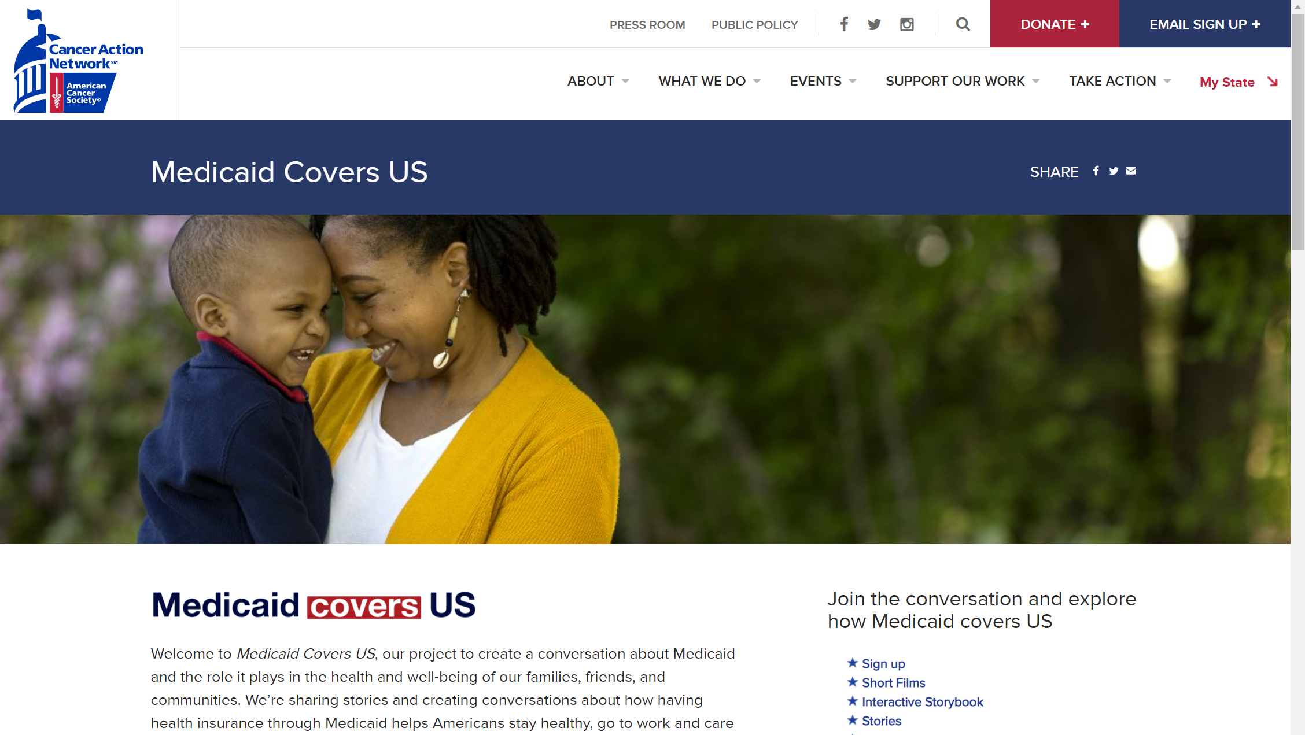

Slide 24
Medicaid and Cancer
Medicaid and the COVID-19 Pandemic
Medicaid’s Role in Addressing Health Disparities
Medicaid Expansion
Messages to Defend Medicaid

Slide 25
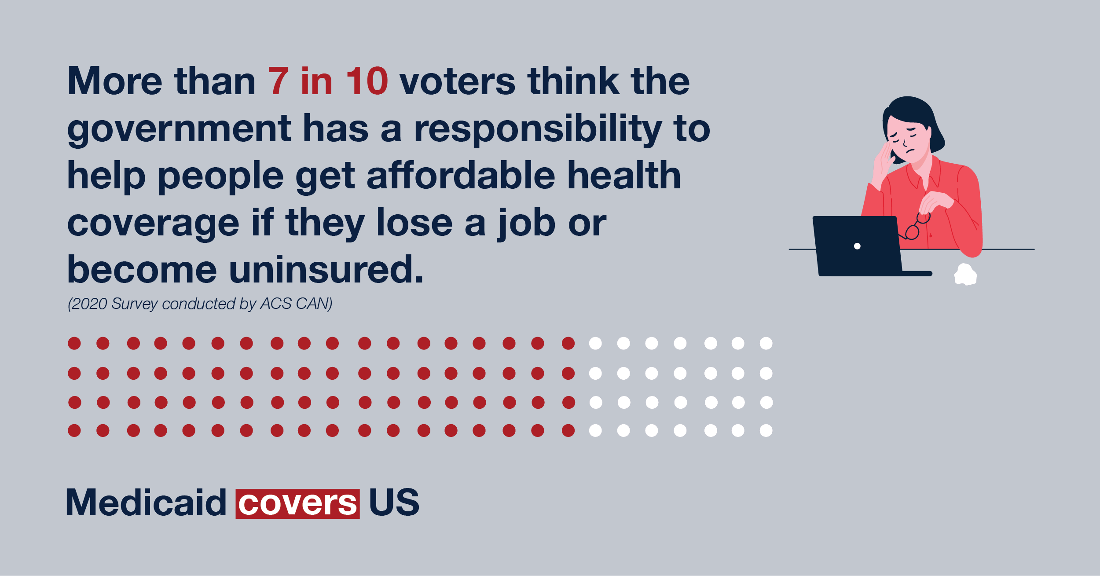
MedicaidCoversUS.org/resources

